Slide 1

Introduction to Deep Learning
Supervised Learning
with Neural Networks
deeplearning.ai

Slide 2
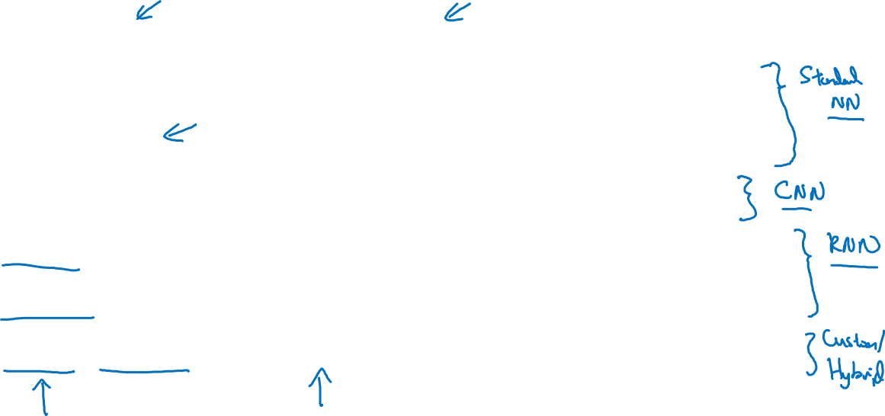
Supervised Learning
Input(x)
Output (y)
Application
Home features
Price
Real Estate
Ad, user info
Click on ad? (0/1)
Online Advertising
Image
Object (1,…,1000)
Photo tagging
Audio
Text transcript
Speech recognition
English
Chinese
Machine translation
Image, Radar info
Position of other cars
Autonomous driving

Slide 3
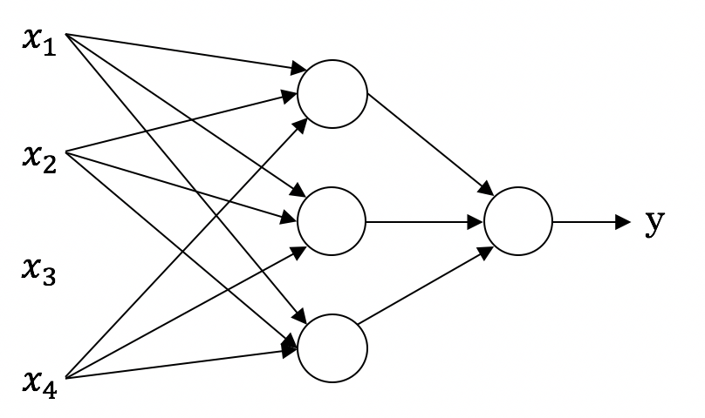
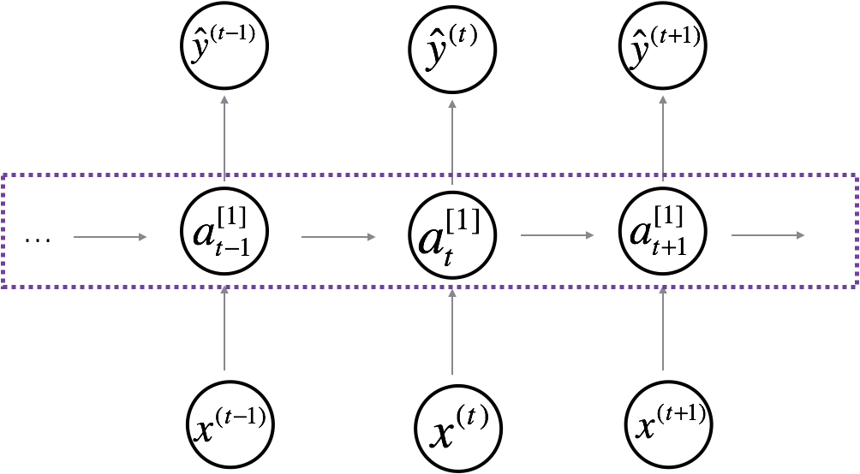

Neural Network examples
Standard NN
Convolutional NN
Recurrent NN

Slide 4



Supervised Learning
Structured Data
Unstructured Data
Size | #bedrooms | … | Price (1000$s)
2104 1600 2400 ⋮ 3000 | 3 3 3 ⋮ 4 |  | 400 330 369 ⋮ 540
Audio
Image
User Age | Ad Id | … | Click
41 80 18 ⋮ 27 | 93242 93287 87312 ⋮ 71244 |  | 1 0 1 ⋮ 1
Four scores and seven years ago…
Text

